Slide 1

BloodLytics
Visualizing Blood Related Statistics

Slide 2

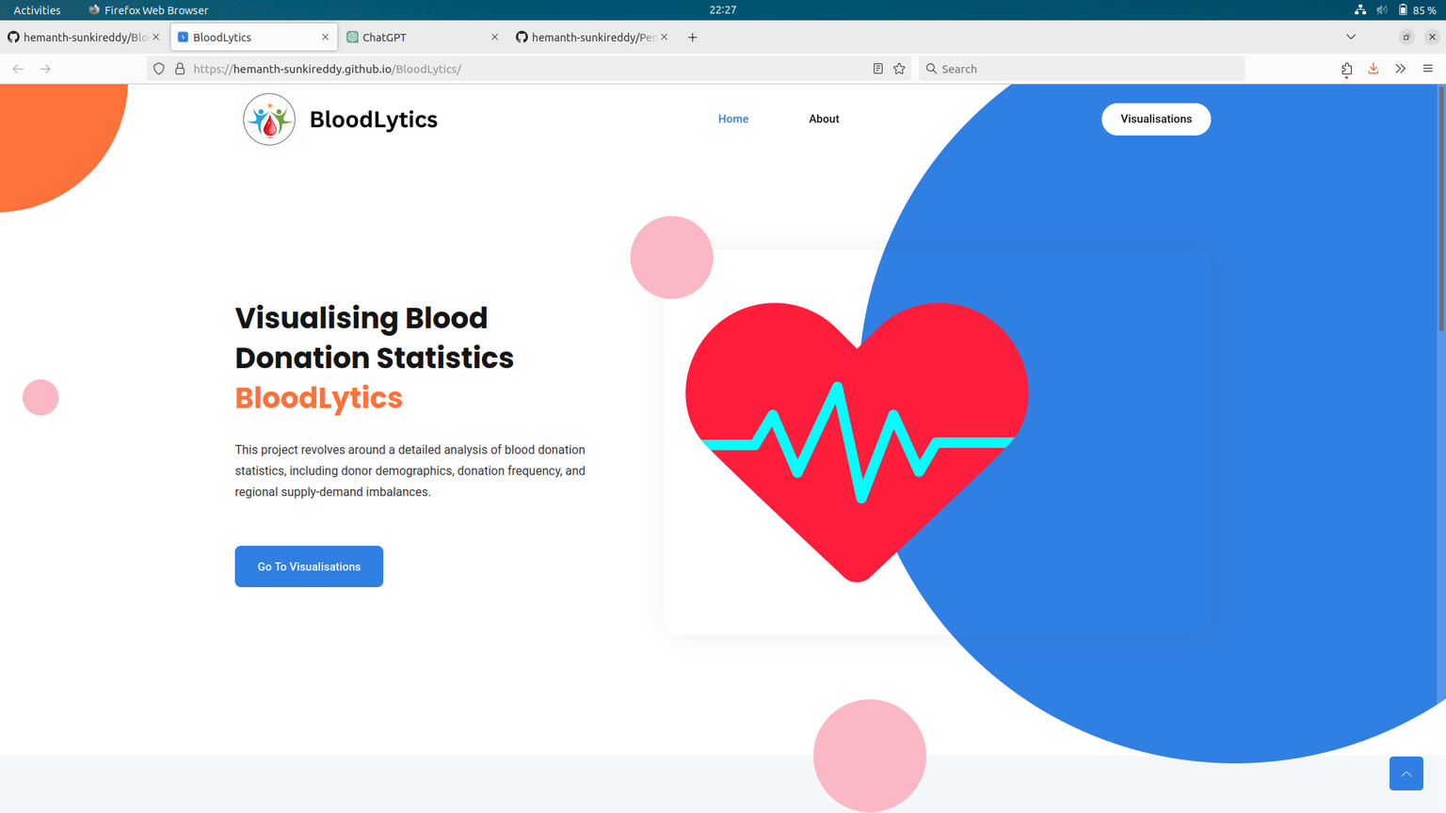
About Project
This project revolves around a detailed analysis of blood donation statistics, including donor demographics, donation frequency, and regional supply-demand imbalances.
Statistical methods are applied, and visualizations like pie charts and bar graphs transform complex data into accessible representations, revealing patterns and disparities.Visualizing this information on a map or a heatmap allows for a quick and intuitive understanding of blood related parameters.

Slide 3








Geographical Distribution of Blood Donations in India
Distribution of Blood Types by Countries
Reason for Not donating the Blood
Visualsations
Blood Donations vs Requirements

Slide 4
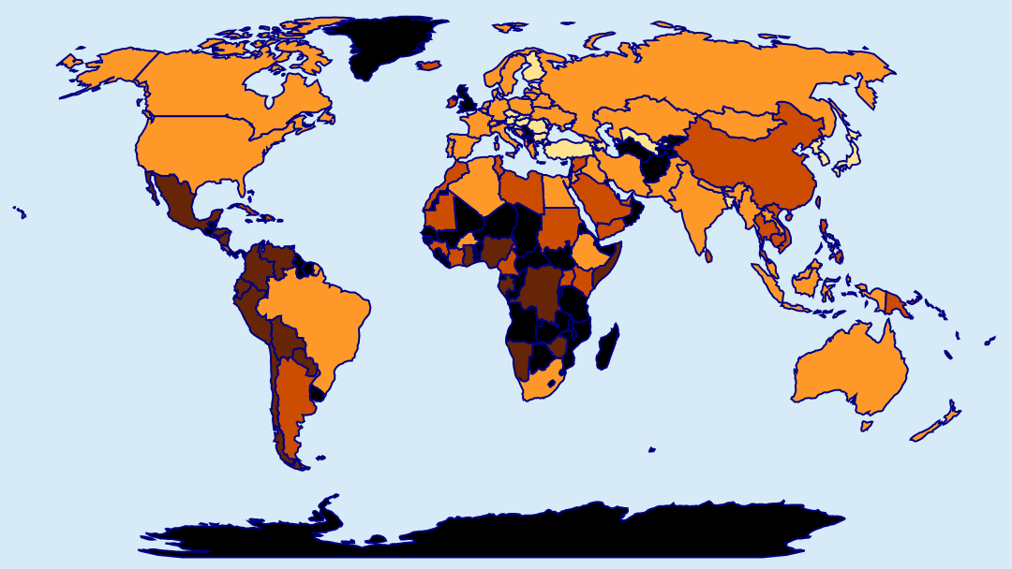
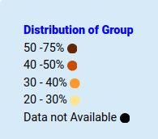

Blood Group: 0+
EMERGENCE OF DIFFERENT TYPES OF BLOOD GROUPS
2
3
1
1
2
3
O Group
A Group
B Group
Central and South America have high frequencies
Central Europe have high frequencies
Middle East and Southeast Asia have high frequencies

Slide 5
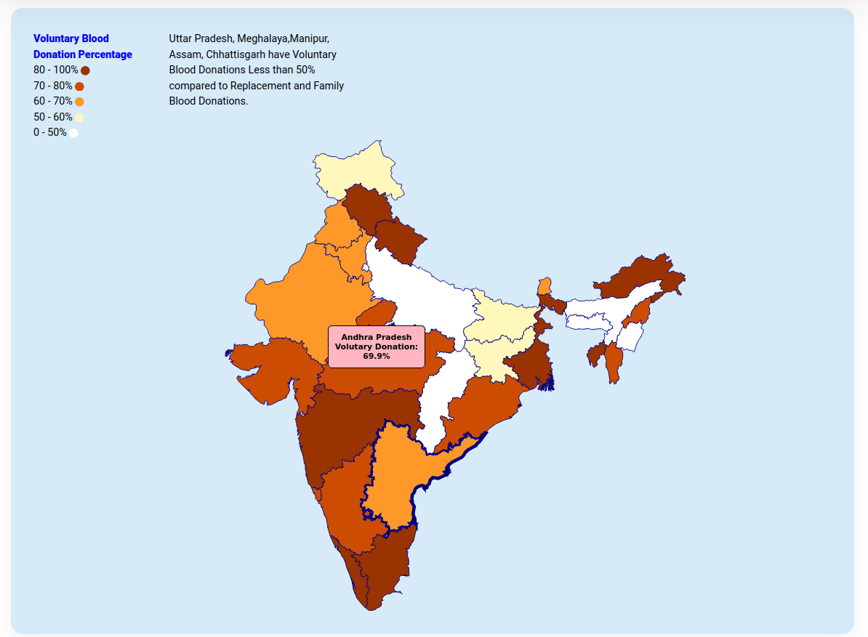
Blood Group: 0+
VOLUNTARY BLOOD DISTRIBUTION IN INDIA
Different types of Blood donations
Voluntary
Family
Replacement

Slide 6



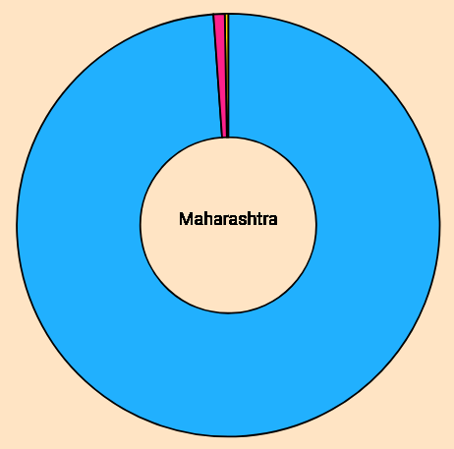
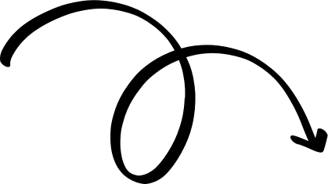
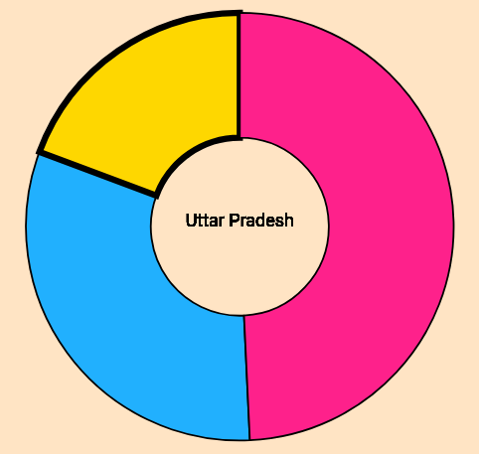
1.2%
Which state Have High Voluntary Blood Donation?
19.3%
Eat something
healthy
98.8%
49.2%
31.4%
Highest Voluntary Donation State
Lowest Voluntary Donation State

Slide 7
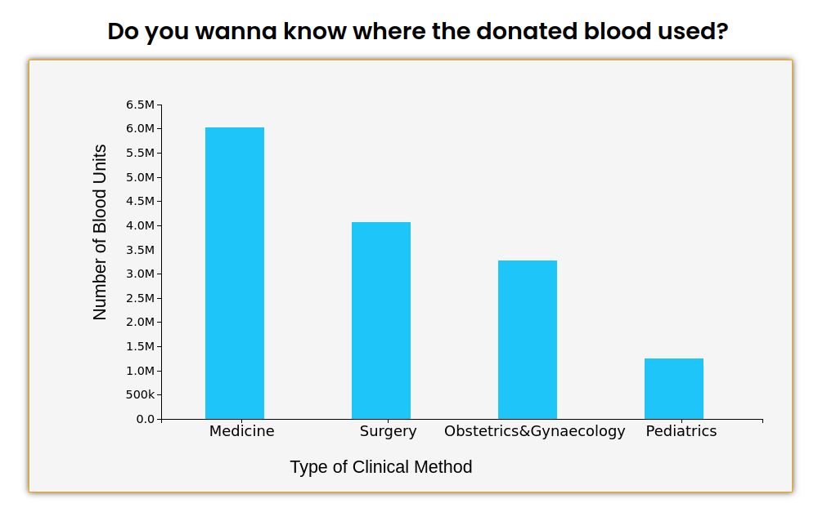
Blood Group: 0+
CLINICAL METHODS WHERE DONATED BLOOD IS USED
Medicine - 6 Million Units
Surgery - 4 Million Units
Gynaecology - 3 Million Units
Pediatrics - 1.2 Million Units
Mapping the Journey of Donated Blood.

Slide 8
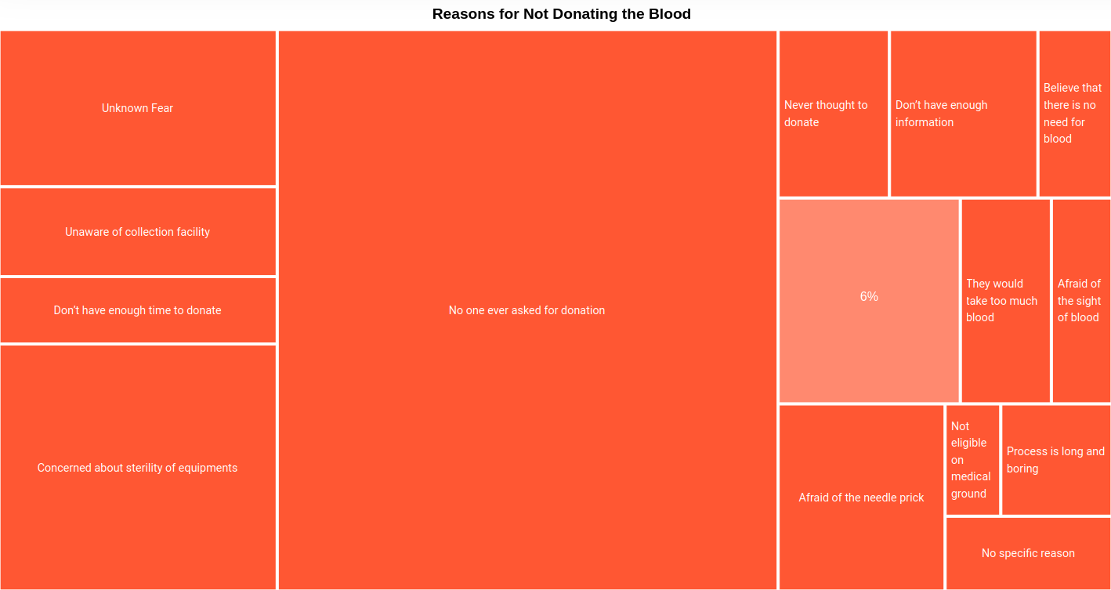
REASONS FOR NOT DONATING BLOOD
We can see multiple reasons and the percentages for the reasons for not donating blood, in the treemap visualization.
Here treemap is used so that different reasons can be compared side by side, and also size of box gives rough idea of their percentages.

Slide 9
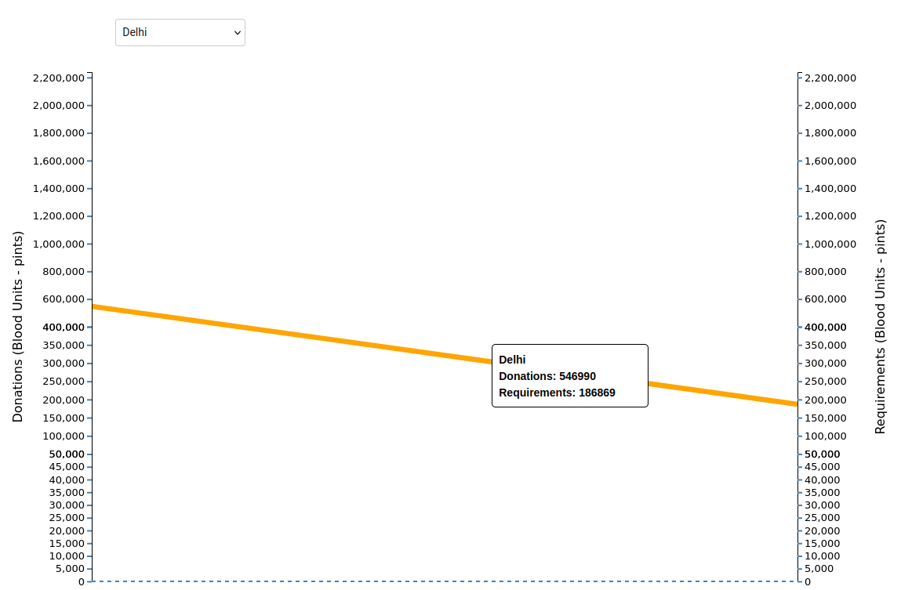
BLOOD DONATIONS VS REQUIREMENTS
Visualization show donations and requirements of each state using slope graph, we can select different states using dropdown.
Here slope graph is used so that donations and requirements can be compared easily side by side, also through inclinations.

Slide 10
Why we used only those visualisations?

Slide 11
Different types of Blood Donations
Clinical Demand of Blood
Visualization used:
Visualization used:
choropleth map (India) and Pie Chart
Bar Chart - Ordered , Aligned
Reason:
Reason:
Clear Representation of Parts to Whole: Blood donation distribution across states can be viewed as parts of a whole (total donations). Pie charts excel in representing this relationship
Ordered Presentation:
Bar charts can present data in a specific order, such as from highest to lowest demand or by any other relevant criteria. This ordered presentation helps viewers quickly understand the distribution of demand across different categories.
Compact Display: Pie charts are compact and take up minimal space

Slide 12
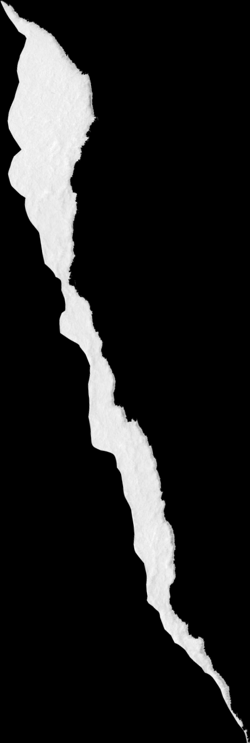
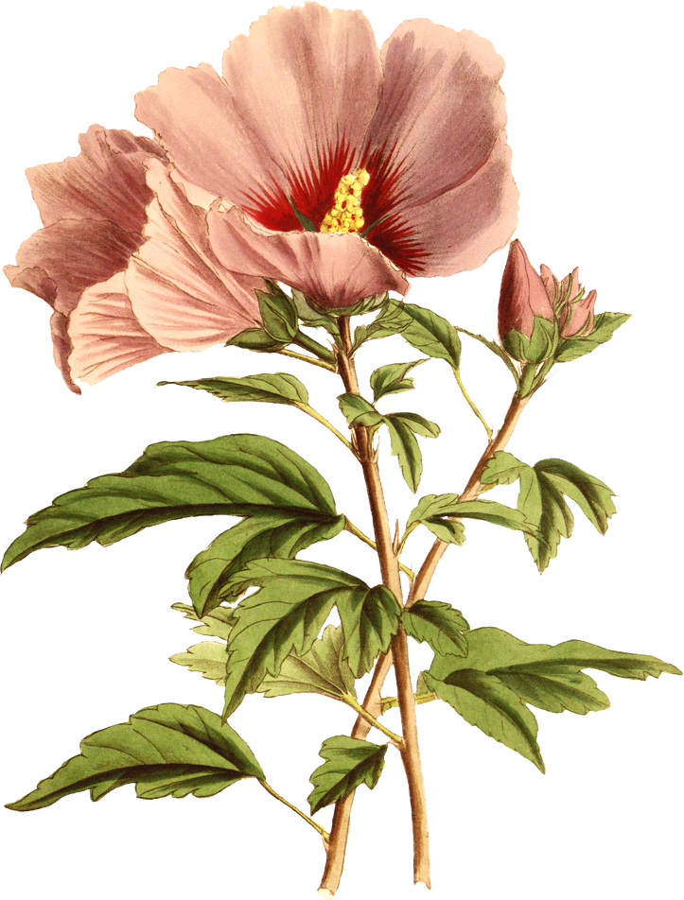
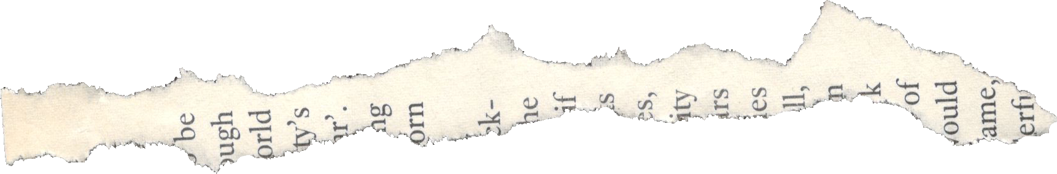
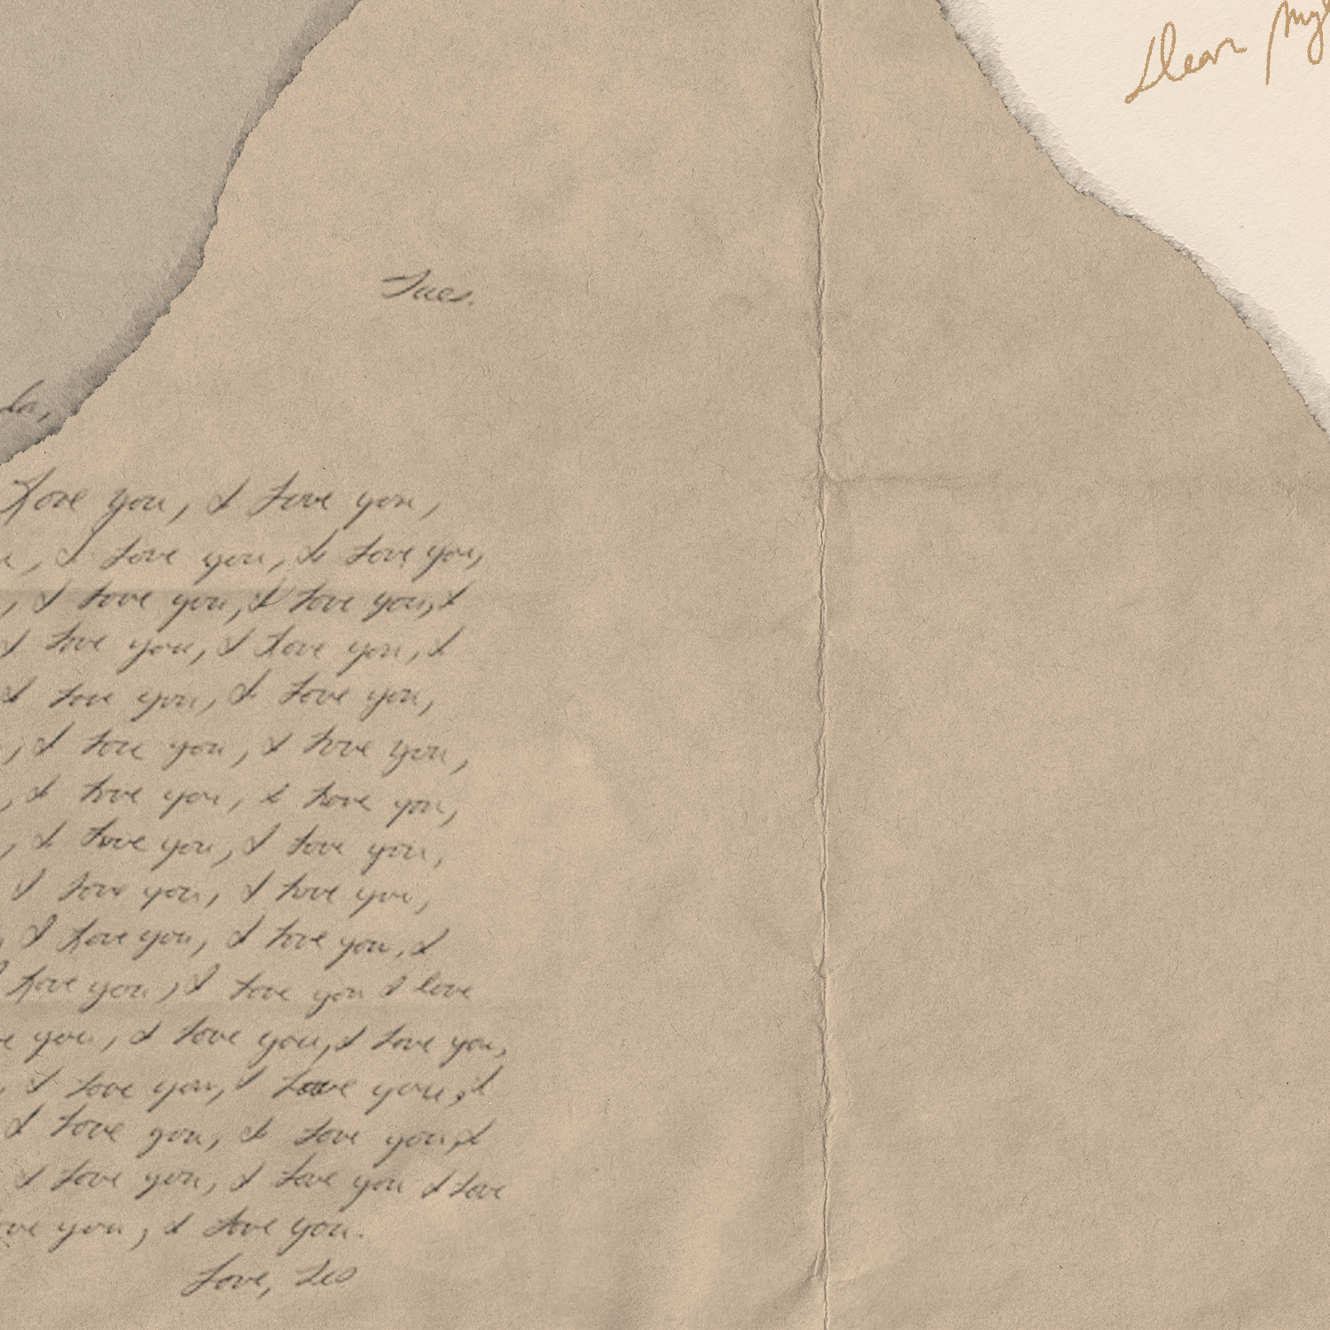



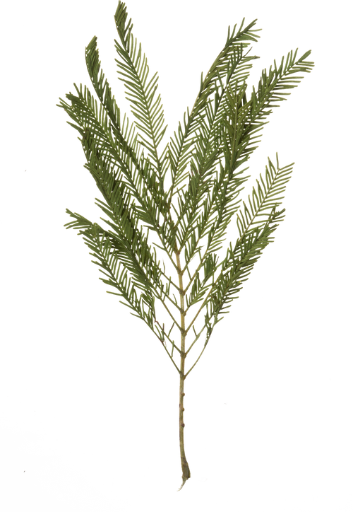


THANKYOU
THANKYOU

